Slide 1
Measuring for Outcome
Getting S**t Done

Slide 2
Goals & Outcomes
To provide students with a perspective on how to evaluate data sources and their relative values, and successfully apply that data.

Slide 3

Big Fat Caveat...

Slide 4
I am not...
I am...
a statistician
a computer scientist
a sociologist
a policy advisor
a data scientist
a deep generalist
a business analyst
a project manager
a coder
an editor
a UX researcher

Slide 5

WHAT IS Evidence-Based Decision Making?
Notes:
Section 1: Header

Slide 6
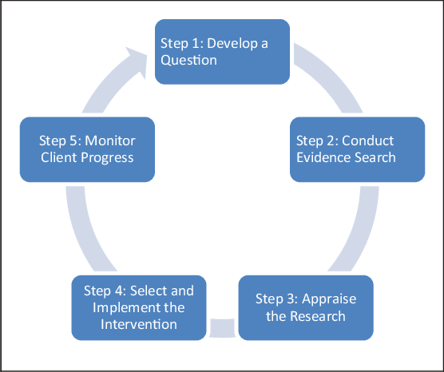
Definition
Evidence-based decision making is a process for making decisions about programs, practices, or policies, based on the most current and best available evidence.
The end product of evidence-based decision making is business intelligence
Notes:
All activities and practices should lead you to a better place than where you started.
Image Credit: https://www.researchgate.net/figure/Rubin-2008-Five-step-evidence-based-practice-decision-making-model_fig1_275594008

Slide 7
What is the intended outcome of all government activity?
Notes:
Question to audience/ Exercise
Image Credit: https://pixabay.com/illustrations/question-mark-note-duplicate-2110767/

Slide 8
“
To decrease overall costs to citizens?
The precise and correct application of evidence-based decision making can create efficient processes that work toward this goal.
Strong Ideas, Loosely Held
Simon King
Notes:
Source:https://www.oreilly.com/pub/e/3252
Possible answer to previous slide
To be deleted possibly?

Slide 9
HOW DO We Collect Data?
Notes:
Section 2: Header

Slide 10
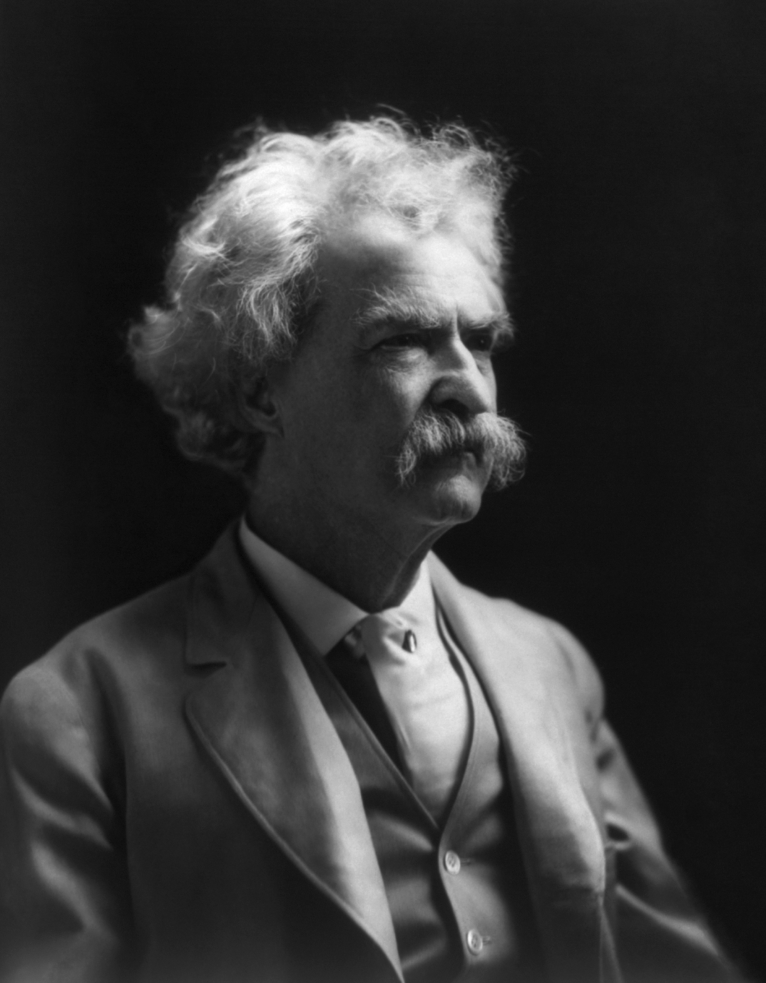
There are three kinds of lies: lies, damned lies, and statistics
“
-Mark Twain in Chapters from My Autobiography

Slide 11
Statistics
We must carefully consider:
source
accuracy
context
Statistics and other data can be persuasive, but are also dangerously misleading if applied incorrectly.

Slide 12
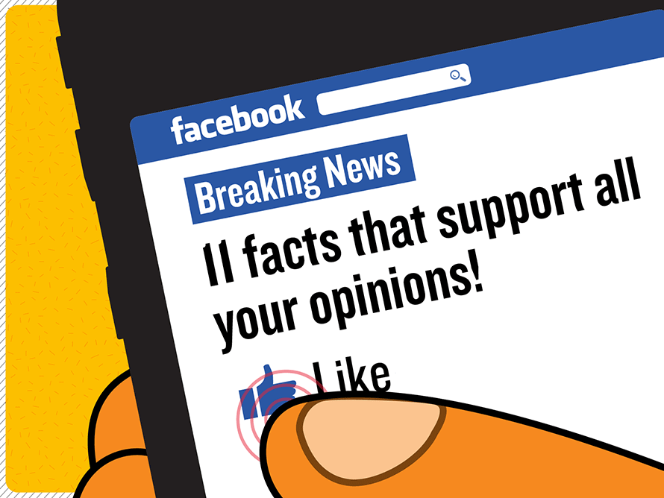
Sources
Consider the source of your statistics.
Do not rely on statistics that come from a potentially untrustworthy or biased source.
Notes:
Hypothetical: A study that says Coca-Cola will make you live to 150 years old, is most likely not reliable, especially if the study was conducted by a company owned or funded by Coca Cola. The study is almost certainly biased.
Image Credit: https://medium.com/@andylindquist/how-confirmation-bias-is-ruining-your-life-and-how-to-fix-it-10620444f3c3
When your measurement process systematically over- or under- emphasizes the value of a population parameter, the result is biased statistics.
Your sources should be free of bias.
Statistical bias occurs when stats are calculated such that they are systematically different than the population parameter being estimated.
Recognize when your stats have been impacted by bias.
Potential forms of bias:
-selection bias
-omitted variable bias
-funding bias
-reporting bias
-exclusion bias

Slide 13

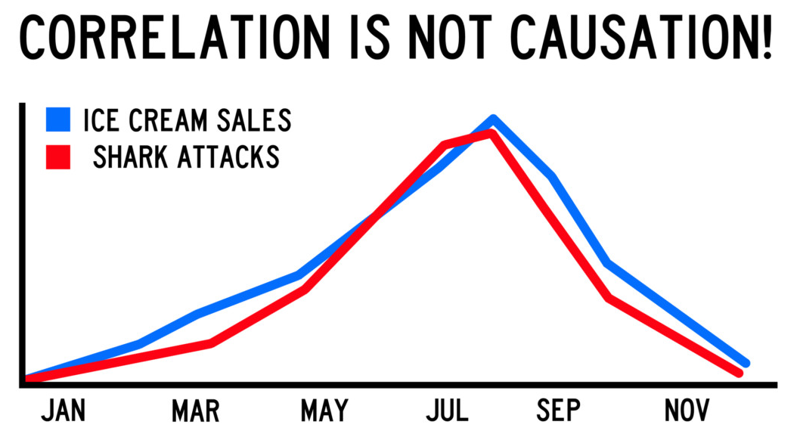
Accuracy
Statistical Accuracy is a measure of statistical bias and relevance.
Consider whether your sample is representative, and large enough to be relevant.
Does your data really support your conclusions?
Notes:
Image Credit #2: https://i.warosu.org/sci/thread/7772046
Correlation does not equal causation:
Consider the null hypothesis
The null hypothesis is useful when considering whether or not two groups differ statistically. It hypothesizes that the two groups are identical. Assume the groups are identical and ask whether collecting samples with large differences is likely or unlikely
Both ice cream sales and shark attacks increase in months when the weather is hot and sunny, but that does not imply that either is caused by the other. In this case they are each caused by a third factor, which is the good weather causing more people to swim at the beach or buy ice cream to cool off.

Slide 14
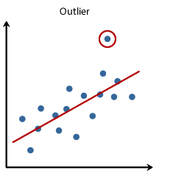
Accuracy: Data Sanitization
Make sure your data set is valid by cleaning up its source.
Consider outliers that should be eliminated.
Notes:
Image Credit: https://blogdotrichanchordotcom.wordpress.com/2016/05/23/outlier-detection-an-overview-and-applications/
Related to Statistical Accuracy.

Slide 15


In a Card Sort-Exercise the fastest participant might take 30 seconds, while the slowest might take 45 minutes.
Results like these, left alone, might disproportionately skew your data in a particular direction.
Notes:
Image Credit #1: https://www.timeanddate.com/timer/
Image Credit #2: https://www.lynda.com/User-Experience-tutorials/UX-Research-Methods-Card-Sorting/546776-2.html

Slide 16
Context
What data are you collecting? How is it being collected?
Does this affect your conclusions?
Web Analytics considers metrics like Time on Site.
Google and Adobe Analytics measure this using timestamps, noting when a page is opened or event is triggered.

Slide 17
Context: Time on Site
Adobe Analytics ends sessions after 30 minutes of inactivity.
Google Analytics ends sessions after 30 minutes of inactivity by default, but can be adjusted to anywhere between a few seconds and several hours.
Consider how this might affect your data.
Notes:
A longer session limit, or no session limit, allows for the possibility that a user has left the site open and has been working in a seperate tab, or walked away from their computer. This could result in an outlier that skews data.
A shorter session limit might not account for the rare case of a user who spend lots of time (more than 30 minutes) reading or using a single page without triggering any events.
Further Eliminated Example:
The session duration is recorded from the first event triggered until the last event triggered.
If a user simply closes the browser, leaving the page without triggering an event, the session duration will not account for the time spent on the site after the last event was triggered.

Slide 18
No single metric tells a complete story.

Slide 19

73.6% of all statistics are made up

Slide 20
Active Data
vs
Passive Data
Active Data is data you need to request from a user
It is sometimes called “explicit data”
Passive Data is data that is collected without explicitly asking the user for it
It is sometimes called “implicit data”
Notes:
Active Data:
Often takes the form of organization initiated research.
Any information you directly ask for.
Eg.:
Name
Address
Preferences
Etc.,
Tends to be qualitative.
Passive Data:
Tends to be collected via automated collection points.
Collected without being asked for directly.
Eg.:
Timestamps
Browser info
Default language
User’s device
Etc.,
Tends to be more quantitative

Slide 21

Active Data
Surveys, Interviews, and Questionnaires are examples of active data collection.
In these cases, the user is asked to participate and provides responses to specific questions.
Notes:
Image Credit: https://www.phorest.com/gb/blog/salon-survey-one-effective-ways-find-clients-want/

Slide 22

Passive Data
Passive Data is collected without explicitly asking the user for information. It is often collected via automated collection points.
An often overlooked example is the data collected by call centers.
Notes:
Image Credit: https://www.bajacallcenters.com/about/news/things-quality-assurance-should-do.html
The call center is an often overlook example of passive data.
(Example of active data to be added still)

Slide 23
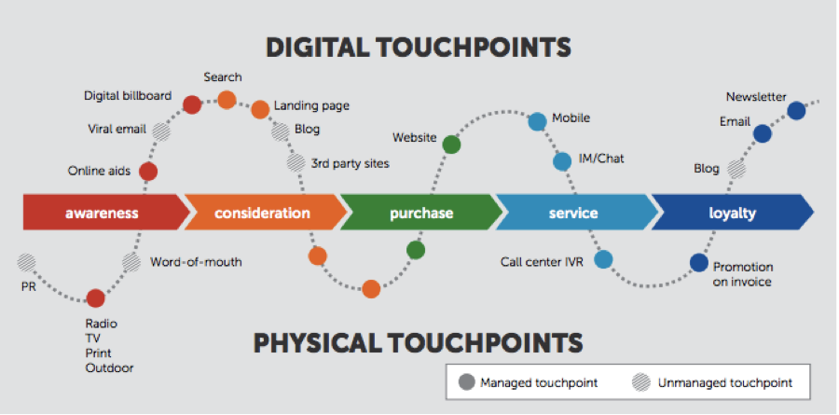
Touchpoints
Notes:
Image Credit: https://marketeer.kapost.com/6-different-types-of-buyer-journey-maps/
Generally speaking, a touchpoint is any way a person interacts with a business or organization.
Broad example of both physical and digital touchpoints along a journey.
More illustrative than specific.

Slide 24
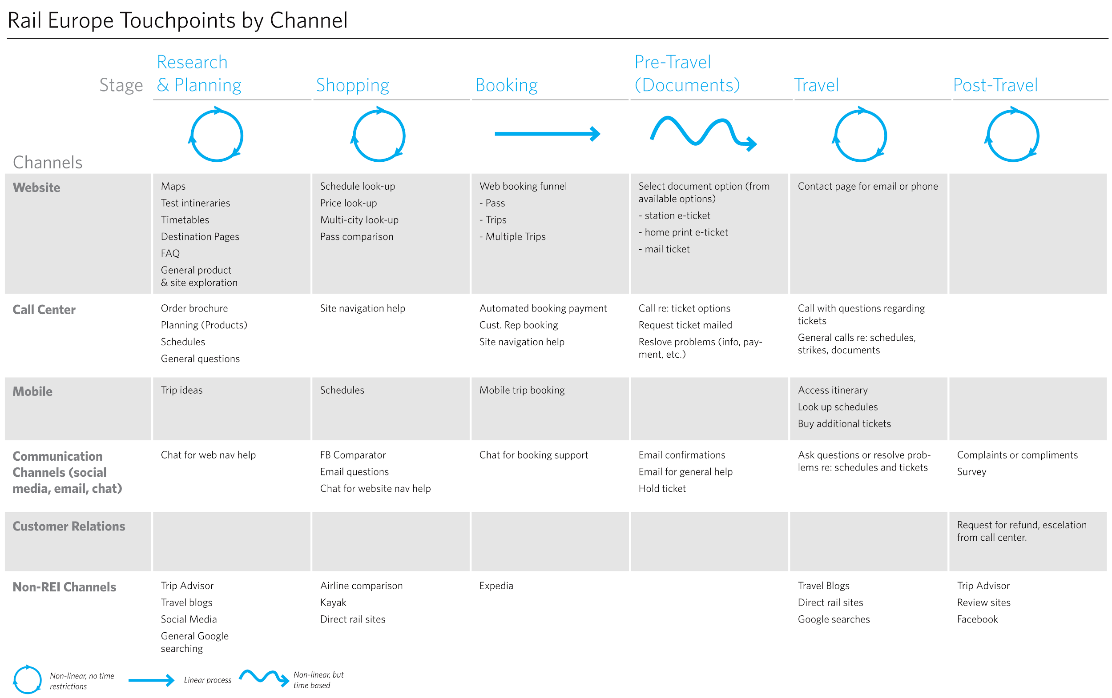
Notes:
Reminder: the audience will have recently done a journey-mapping class and will be familiar with this concept
Image Credit: https://conversionxl.com/blog/customer-journey-maps/
Specific example of journeymap, identifying several touchpoints.

Slide 25
General UX Metrics
Some examples of User Experience Testing Metrics:
Task success rate
Page Views
Time on Task
Time on Page
Time on Site
Unique Visitors
Returning Visitors
Page Load Time
etc.
3 big picture UX metrics that correlate with the success of user experience are: usability, engagement, and task completion
Notes:
A brief selection of a vast amount of metrics and types of data you may be interested in collecting.

Slide 26

Usability
Usability metrics focus on how easily users can accomplish tasks.
For example:
Time on task
Task success
Perceived success
Moments of confusion
Cue recognition
Menu/Navigation use
Notes:
Image Credit: https://www.webpresencesolutions.net/small-business-website-usability-4-things-you-should-know/

Slide 27

2. Engagement
Engagement metrics are concerned with how people interact with a site or application, how much attention they spend on it, how much time they spend in a “flow state” and how much they enjoy it.
For example:
Attention minutes
Happiness rating
Flow state
Total time reading
First impressions
Categories explored
Notes:
Image Credit: https://www.pandologic.com/publishers/trade-publishers/5-reasons-online-audience-engagement-important-everyone/

Slide 28

3. Task Completion (Conversion)
Conversion metrics are important and consider how you can increase engagement.
For example:
Micro-conversion count
Brand attribute
Conversion rate
Likelihood to recommend
Net Promoter Score (NPS)
Trust Rating
Likelihood to take action
etc.,
Notes:
Image Credit: https://www.123rf.com/photo_27709273_stock-vector-flat-design-modern-vector-illustration-concept-of-the-website-traffic-conversion-growth-webpage-sear.html

Slide 29
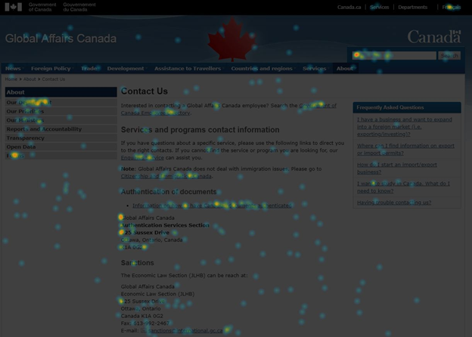
Heatmap

Slide 30

Analyzing Data
Notes:
Section 3: Header

Slide 31

How do we decide what data to use, how to analyze it, and how to present it effectively?

Slide 32
Business Objectives
Business Objectives are the results you ultimately hope to achieve.
Notes:
Business objectives should inform the way you utilize and present data.

Slide 33

Government of Canada Objectives
Increase Public Trust
Strong Middle Class
Sustainable Infrastructure
Fair and Open Government
Safety and Security
Healthy Canadians
Etc.,
Notes:
Source: https://www.canada.ca/en/privy-council/campaigns/mandate-tracker-results-canadians.html
Image Credit: https://www.canada.ca/en.html
Some specific examples of organizational objectives.

Slide 34

KPI
A KPI is a Key Performance Indicator: a measure of your performance against key business objectives.
a measurable value
demonstrates how effectively you meet business objectives
high-level focus on performance of the organization
or Low-level focus on processes, departments, or employees
should be defined by your desired outcome
Notes:
Comparison to CSFs (Critical Success Factors)
KPIs are what to look for to see if you are succeeding
CSFs are what you will need to do to succeed.
SMART objectives:
Specific
Measureable
Achievable
Relevant
Time Bound
Image Credit: https://www.ragan.com/14-kpis-that-pr-pros-should-be-tracking/

Slide 35
Mixed Method Research
Qualitative:
Voices, stories, complex phenomena
Quantitative:
Objectivity, efficiency, statistical trends, data relationships
Gathering and combining qualitative and quantitative research to gain a better understanding than either provide on their own.
Understand the strengths and weaknesses of each method in order to combine them.
Notes:
Source: http://delshimy.com/presentations_all/2018_CanUX_DE.pdf
Triangulation:
In navigation: using two known locations to pinpoint a third
In Data: using one or more methods of research to arrive at unique insights

Slide 36
Good and Bad Criteria for Measurement?
Notes:
Question to audience/ Exercise
Bad: Media Monitoring
Good: Usability Research and Testing
Image Credit: https://pixabay.com/illustrations/question-mark-note-duplicate-2110767/

Slide 37
Research Question
It is crucial to clearly define your Research Question before any testing begins.
The Research Question is not something you literally ask during the testing.
Your other Study Questions should inform you on the answer to your Research Question by providing relevant data.
Notes:
Image Credit: https://www.kisspng.com/png-question-mark-red-clip-art-big-question-mark-589930/

Slide 38

Pareto Principle
Results
80%
Efforts
20%
Notes:
If optimization is the goal, focus on the essential 20%
Often in government inclusivity and accessibility for all are necessary, in which case you need to consider all 100%, including people in the margins you may not initially consider.

Slide 39
Diminishing Returns
Diminishing Returns refer to a point at which the profits/benefits gained are less than the amount energy or resources being invested.
Notes:
Example provided on following slide.

Slide 40
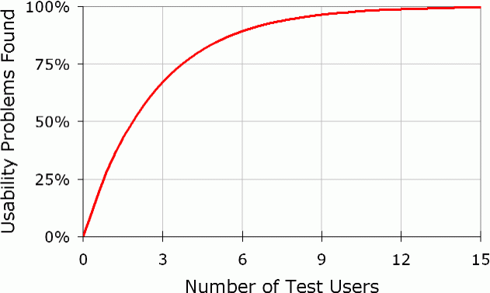
Testing 0 Users will provide you with 0 results
Notes:
Testing even a single user provides you with observations you otherwise would not have.
When elaborate testing cannot be done, Guerilla testing with a mock-up is better than nothing.
The Nielson Norman Group finds elaborate usability testing to be a waste of time and resources.
It is more effective to perform several, smaller usability tests.
One user gives you completely unique results
Two Users provide new insights with some overlap
Three users provide considerable overlap but some new insight
Five users and beyond tend to observe the same results repeatedly with increasingly small variations.
If the changes made by a first test do not resolve all issues, a second, and third test can increasingly identify remaining issues more clearly.
Image Credit: https://www.nngroup.com/articles/why-you-only-need-to-test-with-5-users/

Slide 41

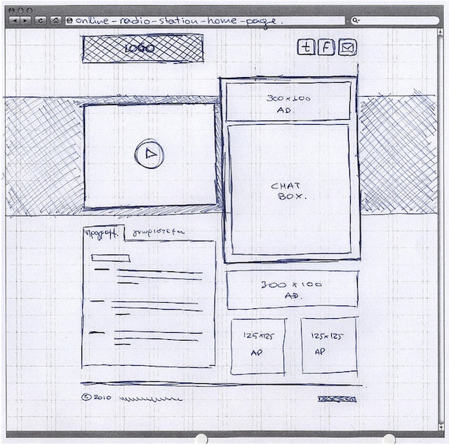
Guerilla Usability Testing
“...pouncing on lone people in cafes and public spaces, quickly filming them whilst they use a website for a couple of minutes...”
When usability testing is not possible, impromptu guerilla tests can still provide useful feedback.
Watch strangers, coworkers, or anyone available, and ask them to think aloud about how a task might be accomplished. This can be done with a complex prototype, or a basic sketch
Notes:
Image Credit #1: https://www.uxbooth.com/articles/the-art-of-guerrilla-usability-testing/
Image Credit #2: https://speckyboy.com/web-mobile-wireframe-sketch-examples/
A type of user testing that can be done when time and resources are in short supply.

Slide 42
How Do You Measure Public Trust?
Notes:
Question to audience/ Exercise
Challenges:
This is difficult to measure because of its inherent intangibility.
Generally speaking the public can be surveyed. Their responses and expressed beliefs are one metric by which public trust and the results of policy can be measured.
Measuring Public Trust and the Results of Policy:
Changes in professed values/beliefs
Number of partners supporting an issue
Level of voter registration
Media coverage
Social and physical conditions
Habitat diversity
Public health
Poverty
Image Credit: https://pixabay.com/illustrations/question-mark-note-duplicate-2110767/

Slide 43
When should you use evidence-based analysis?
Short Answer:
Always

Slide 44
Long Answer
client’s engagement
measurements as a checkbox
redundant testing
no new outcome
testing frequency
Notes:
Redundant Testing:
If the testing tells you something you have already demonstrated, further testing may not be the best use of your time and resources.
No New Outcome:
If an outcome can not be changed, or there is not a willingness to look for new outcomes, time and resources should not be wasted on extensive testing.
Testing Frequency:
It is not useful to overdo usability testing.
If the results of testing cannot be successfully implemented for 6 months, there is no reason to do testing on a monthly basis.
Fit your testing to the frequency cycle in which it can be useful
Image Credit #1: https://blog.ipleaders.in/indian-evidence-act-nutshell/
Image Credit #2: https://edgeup.asus.com/2015/build-a-pc-checklist/

Slide 45

Caveat
In some cases, testing can be used to back up what you already know.
Official testing with a consultant can strengthen your suggestions or proposals.
Notes:
Image Credit: https://www.salesforce.com/hub/analytics/why-data-strategy-is-critical/
In many cases heuristic analysis can give you all the information you need to make suggestions.
It is still sometimes useful to officially test with a consultant to get buy-in from management.
(Relevant to the next section of the presentation “How to Get It Done”)

Slide 46
Long Answer
Ideally, your client should:
understand their business goals
be willing to leverage business intelligence
be interested in using the data collected to achieve their specific goals

Slide 47

HOW TO Get it Done
Notes:
Section 4: Header
Justifying User testing to senior management.

Slide 48

Appealing to Senior Managers
In some cases, justifying usability testing to senior managers can require convincing.
It is important to appeal to the outcome and value of the testing.

Slide 49
So What?

Slide 50
Outcome
What is the intended outcome of the testing?
Clearly define your Research Question:
What questions are you trying to answer?
What problems are you trying to solve?
What objectives are you trying to achieve?

Slide 51
Why Should I Invest in This??

Slide 52

Value
Demonstrate that testing and evidence-based analysis are providing a value to your organization.
Convince managers of UX Testings capability to identify issues, generate more traffic, and make processes more efficient.
Notes:
Image Credit: https://www.cmo.com.au/article/586510/why-customer-centricity-about-predicting-customer-lifetime-value/

Slide 53

What is the Value of Usability Testing?
Generally, UX Testing lessens the risk of user errors, and increases user satisfaction.
Arguably more important: Early UX testing save you time and money
Notes:
Image Credit: https://uxplanet.org/the-essential-toolbox-of-ux-testing-methods-6e8e564768c3

Slide 54
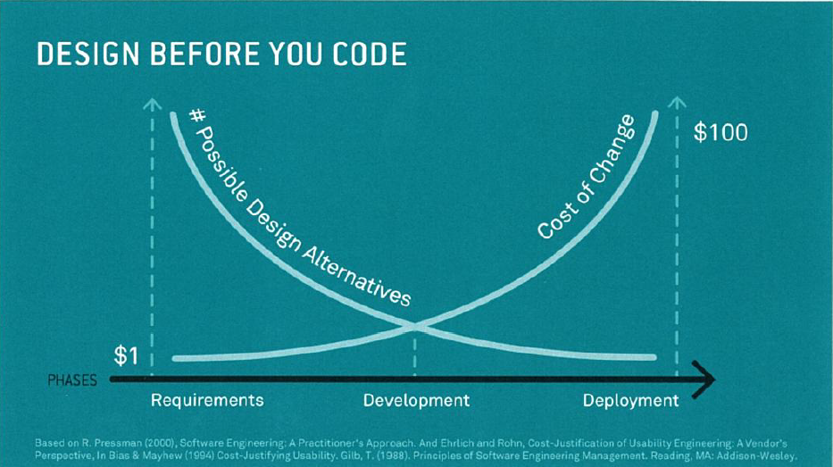
Return on Investment
Notes:
ROI Youtube Video: https://www.youtube.com/watch?v=O94kYyzqvTc&feature=youtu.be

Slide 55
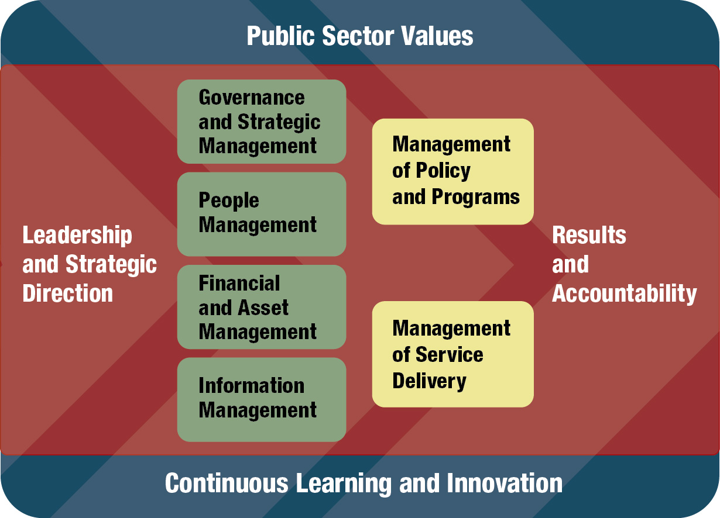
Performance Measurement
The Management Accountability Framework is accompanied by annual assessment of management practices and progress on government-wide priorities.
Ultimately, management is assessed on their progress in specific areas.
Demonstrable UX findings, recommendations, and results don’t just improve the site. They also lead to favourable evaluations for senior management.
Notes:
Source: https://www.canada.ca/en/treasury-board-secretariat/services/management-accountability-framework.html
Image Credit: https://www.canada.ca/en/treasury-board-secretariat/services/management-accountability-framework.html

Slide 56
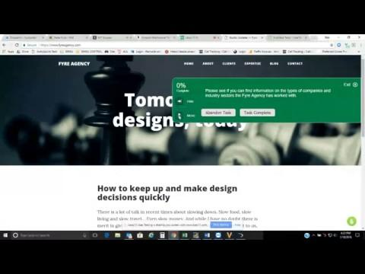
Usability Test Example

Slide 57
Clear Writing and Data Visualization
To express the value of testing, visualize your data and write as clearly and simply as possible.
Notes:
For more information and tips, consult the Canada.ca Content Style Guide:
https://www.canada.ca/en/treasury-board-secretariat/services/government-communications/canada-content-style-guide.html
Or tools like the Hemingway App.
Content style guide expands on the rules already presented, and offers several more, along with examples.
Hemingway app identifies common errors and provides alternatives.
The app identifies dense, complex sentences and words, and offers suggestions for replacements or structure changes.
It also identifies that grade level of the text’s readability.

Slide 58
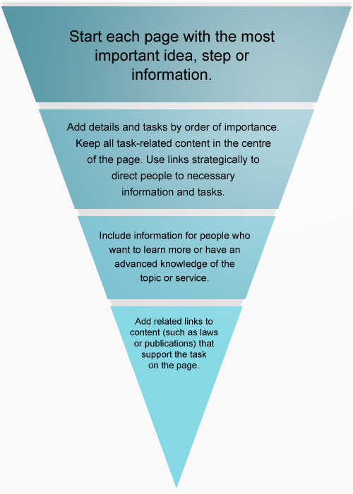
Get to the point.

Slide 59



75%
Men 25%
vs
Women 75%
are women
Notes:
Big Numbers are more memorable than charts.
Graph Credit: EDRMS #12001404 Summarization from Visualization Training

Slide 60
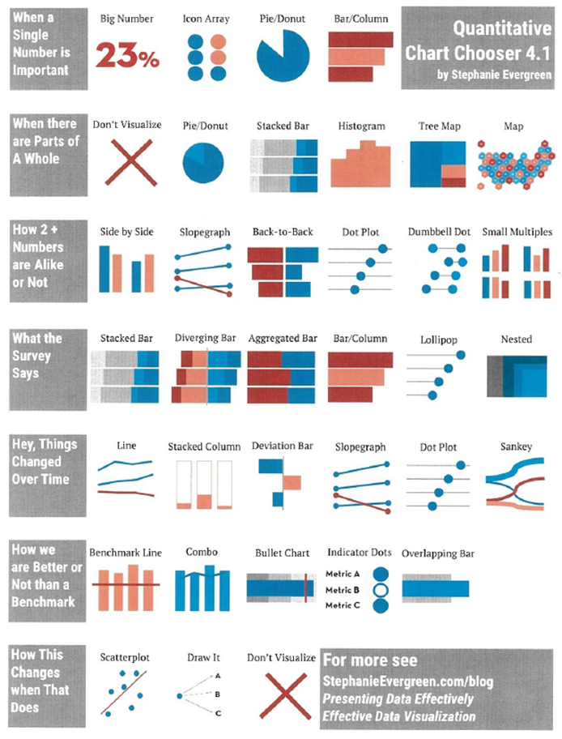
Notes:
Visualize your data based on the information you are trying to convey.
Image Credit: EDRMS #12001404 Summarization from Visualization Training

Slide 61
How to Frame Your Request in a Broader Context

Slide 62

Beyond 2020
The three identified areas of focus are titled:
Agile
Inclusive
Equipped
In 2013 Blueprint 2020 was established to grow a spirit of innovation and collaboration across the Public Service.
Beyond 2020 is a refreshed framework with a focus on mindsets and behaviours.
Notes:
Agile:
Mobilizing people and resources, experimenting, and empowering the workforce
Inclusive:
Co-create by bringing different perspectives to the table and creating an environment where everyone is comfortable
Equipped:
Designing optimized work environments, learning, and embracing new technologies and tools
Source: https://www.canada.ca/en/privy-council/services/blueprint-2020/beyond-2020.html
Image Credit: canada.ca

Slide 63

Behavioural Insights
Behavioural Insights (BI) considers how people behave and make decisions.
This insight is then used to experiment with low-cost interventions and measure their impact.
Notes:
Determined by a combination of psychology, economics and predictive analytics.
Affected by bias, anchoring, choice overload, overconfidence, herd behaviour.
Image Credit #1: http://cfe.org.uk/expertise/behavioural_insight_research/
Image Credit #2: http://mandegar.info/?l=QUT++Behavioural+economics+psychological+insights+into

Slide 64

Experimentation
“Ethical and rigorous experimentation is central to the Government’s focus on evidence-based policy-making.”
Experimentation: “exploring, testing, and comparing the effects and impacts of policies, interventions, or approaches through the use of sound and appropriate research methodology.”
Notes:
Image Credit: IB # 12033437 CoP Experimentation Deck

Slide 65

Experimentation
Experimentation helps us:
understand what works
decrease risks
iterate and improve
It can only occur once the problem and solutions have been identified, a good experiment can be conducted and the experiment will generate new and useful information
Notes:
Image Credit #1: https://www.alamy.com/stock-photo/smoke-test-tube.html?page=3

Slide 66

Innovation
Organizations must work in new and inventive ways, focusing on evidence-based analysis of what does and does not work.
This means researching, analyzing, and experimenting with the uses of emerging technologies.
Notes:
Image Credit: https://www.cio.com/article/3142322/how-it-leaders-can-define-and-drive-it-innovation.html

Slide 67
Emerging Technologies
Machine Learning - an application of AI that provides systems the ability to automatically learn and improve from experience and data without being explicitly programmed
Data Science - mining large volumes of departmental data, monitoring and analyzing social media, and modeling global factors affecting departmental planning and decision making
Voice Assistant/Chatbox - assisting automation, predictions, and actions
Artificial Intelligence - intelligent machines that work and react like humans.

Slide 68
Testing and Analysis Community
There are many communities of people encountering the same problems, asking questions, and developing new techniques and practices.
Behavioural Insights Community of Practice: https://gcconnex.gc.ca/groups/profile/21911625?language=en
ESDC Innovation Lab Group: https://gcconnex.gc.ca/groups/profile/25886401/esdc-innovation-lab-lab-dinnovation-dedsc?language=en
Data Science Group: https://gcconnex.gc.ca/groups/profile/5394852?language=en
Data Visualization Group: https://gcconnex.gc.ca/groups/profile/24345174?language=en
UX Discussion Forum Group: https://gcconnex.gc.ca/groups/profile/10947731?language=en

Slide 69
Other Challenges to Testing
Recruiting participants
The government cannot directly pay for or hire participants
As such, consultants must be hired to research, test, and provide recommendations
Unfortunately, this means we never build in-house experience or capacities

Slide 70

Other Challenges to Testing
Rules regarding certain testing and analysis software is still unclear
Where third-party cloud software is concerned rules are still being developed concerning:
Who owns the data?
Can it be exploited?

Slide 71
Recap
Evidence Based Decision Making is a process for making decisions based on the most current, best available information.
Lies, Damned Lies, and Statistics.
No single metric tells a complete story.
Testing 0 users will give you 0 results. Optimize your research.
Convince your managers to participate in UX testing by showing them clear intended outcomes that have value.

Slide 72
Thanks for Listening
Contact me
Email: Damien.Middleditch@international.gc.ca Twitter
LinkedIn
Presentation compiled and edited with the assistance of Josh Wenner

